Slide 1
Welcome to UCD from UCDSU!

Slide 2
What we do
Our aim
Peer to peer support, campaigns on issues affecting students, events, representation on boards & committees and lots more!
Where to find us?
Old Student Centre - Help Desk on the ground floor beside Astra Hall and before the Student Health and Counselling Centre.
Always pop in to say hello, we’d love to see you!
We also have two SU shops on campus; JJL and Sports Centre.
Ensure everyone feels supported and empowered in their student experience.
Organise various events and campaigns throughout the year.
Provide peer to peer support on a range of issues and representation at disciplinary meetings.
Act as the student voice on various university boards and committees.

Slide 4
Engaging with the Union
Every student is already a member of the Students’ Union. Here are just a few ways to get involved:
Exercise your democratic rights and vote in the class rep and executive elections.
Volunteer by becoming a community rep.
Join a campaign or come to an event.
Run for Class Rep!
Nominations open: September 15th (you only need 5 signatures from people in your course)
Elections: October 4th & 5th.
Email campaigns@ucdsu.ie with any questions!

Slide 5
President: Martha Ní Riada
president@ucdsu.ie
Education: Sarah McGrath
education@ucdsu.ie
Graduate: Marc Matouc
graduate@ucdsu.ie
Welfare: Jill Nelis
welfare@ucdsu.ie
Entertainments: Neo O’Herlihy
entertainments@ucdsu.ie
Campaigns: Miranda Bauer
campaigns@ucdsu.ie
How to Contact Us
To keep updated follow us @UCDSU on Instagram, Twitter & Tiktok

Slide 6
Notes:
Ucdsu ball - early bird tickets on sale - 8 til late - wear whatever is comfortable, no formal ball attire needed.

Slide 7
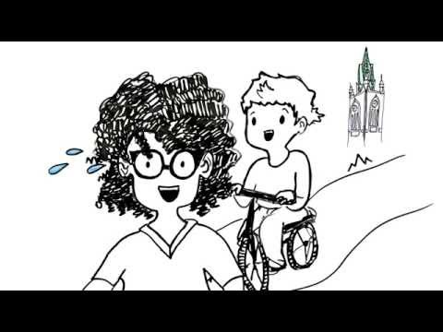
Building a Culture of Consent
Remember to take your Active Bystander training on Brightspace and to take the pledge! There’s zero tolerance for bullying, harassment, or sexual misconduct here in UCD

